Slide 1
Hans
EXAR/CADEKA
Precision Applications
大盛唐电子集团有限公司
www.szdst.com.cn
400-662-1-662
OCT 2012

Slide 2
Agenda
Precession Product
  Instrumentation amplifier
  General precession amplifiers
  Upcoming precession amplifiers
Precession application
  Current Shunt
  Pressure Sensor
  Weight Scale Sensor
  Flow Meters
  Medical
Precession relate specs and significance

Slide 3
Precession Product Overview - Amplifiers
10-23-2012

Slide 4
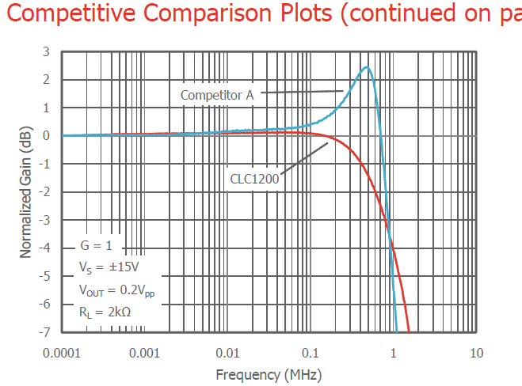
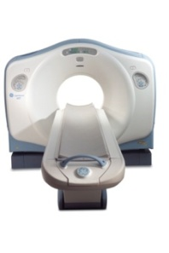
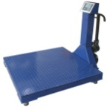
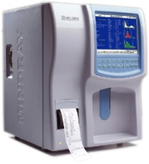
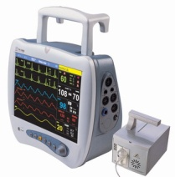

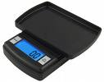
CADEKA’s First Precision Amplifier
CLC1200 - Low Cost Instrumentation Amplifier
  Drop-in replacement for AD620A
  Samples available NOW!
  Mass Production NOW!
Applications
Industrial, Instrumentation
  Bridge Amplifier
  Weigh Scales
  Sensor/Transducer Interface
  ATE
  Process Control Systems
  Strain Gauge Amplifier
Medical
  ECG and Medical Instrumentation
  MRI (Medical Resonance Imaging)
  Patient Monitors

Slide 5
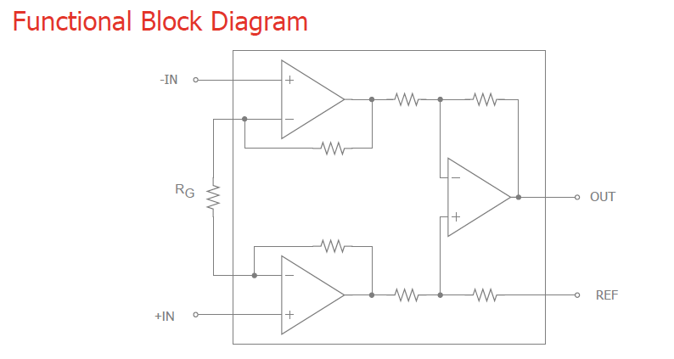
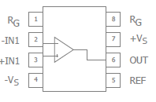
CLC1200
Low Cost Instrumentation Amplifier
Available NOW!!
Key Features
Direct Replacement for AD620A
Wide gain range ( 1 to 10,000) set by one external resistor
Wide Supply Range ±2.3V to ±18V
125µV Max Input Offset Voltage
Low Power 1.3mA Supply Current
9nV/√Hz Input Voltage Noise
Available in 8-lead DIP and SOIC Packages
Applications
Industrial, Instrumentation
  Bridge Amplifier
  Weigh Scales
  Sensor/Transducer Interface
  ATE
  Process Control Systems
  Strain Gauge Amplifier
Medical
  ECG and Medical Instrumentation
  MRI (Medical Resonance Imaging)
  Patient Monitors
Why We Will Win
Industrial, Instrumentation
  Low Offset Voltage and High CMRR offer exceptional accuracy
  Low Noise
  Low Cost
Medical
  Low Noise
  Low Cost

Slide 6

CLC1200 Key Competency
Superior Performance vs. Competitors Solution
  Gain Error – Better measurement accuracy for sensitive medical applications
  Voltage Offsets –
  Input Voltage Noise –
Applications
Industrial, Instrumentation
  Bridge Amplifier
  Weigh Scales
  Sensor/Transducer Interface
  ATE
  Process Control Systems
  Strain Gauge Amplifier
Medical
  ECG and Medical Instrumentation
  MRI (Medical Resonance Imaging)
  Patient Monitors
Key Competitors
AD620_Analog Devices AD623_Analog Devices LT1920_Linear Technology INA114A_Intersil INA128_Intersil

Slide 7
CLC1200 Key Competency - continue
Parameter | Conditions | CLC1200 | AD620 | Unit
Cost
Gain Error | G=1 | .01 | 0.03 | %
 | G=10 | .1 | 0.15 | %
 | G=100 | .1 | 0.15 | %
 | G=1000 | .35 | 0.4 | %
Nonlinearity | G = 1–100, RL = 10 kΩ | 10 | 10 | ppm
 | G = 1–100, RL = 2 kΩ | 10 | 10 | ppm
Input Offset, VOSI |  | 15 | 30 | µV
Output Offset, VOSO |  | 200 | 400 | µV
Offset Referred to the Input vs. Supply (PSR) | G=1 | 100 | 100 | dB
 | G=10 | 120 | 120 | dB
 | G=100 | 140 | 140 | dB
 | G=1000 | 140 | 140 | dB
Input Bias Current |  | 0.5 | 0.5 | nA
Average TC |  | 3 | 3 | pA/°C
Common Mode Ratio DC to 60 Hz with 1 kΩ Source Imbalance | G=1 | 90 | 90 | dB
 | G=10 | 110 | 110 | dB
 | G=100 | 130 | 130 | dB
 | G=1000 | 130 | 130 | dB
Short Circuit Current |  | ±20 | ±18 | mA
Slew Rate |  | 1.2 | 1.2 | V/µs
Input, Voltage Noise, eni |  | 6.6 | 9 | nV/√Hz
Output, Voltage Noise, eno |  | 70 | 72 | nV/√Hz
Quiescent Current |  | 1.3 | 0.9 | mA
Cadeka = Lower Cost
Cadeka = Better Gain Error
Cadeka = Superior Offset Voltages
Cadeka = Better Input Voltage Noise

Slide 8
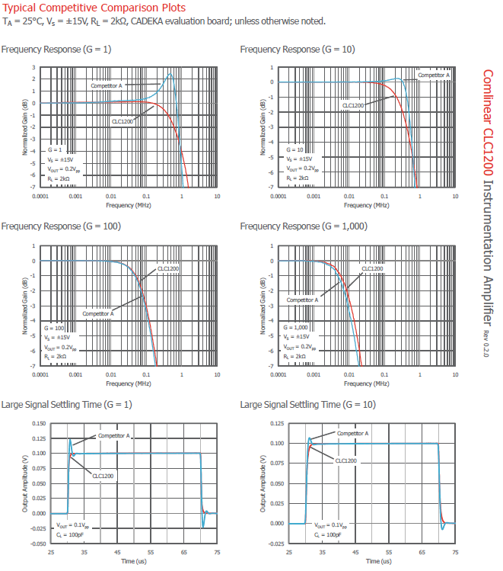
Competitive Comparison
CLC1200 vs. AD620 comparison plots included in CLC1200 data sheet

Slide 9
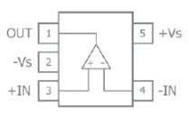
CLC1003
Single 20MHz RRIO Amplifier with <1mV Max Vio
Key Features
<1mV max input offset voltage
0.00005% THD at 1kHz
5.3nV/√Hz input voltage noise >10kHz
-90dB/-85dB HD2/HD3 at 100kHz, RL=100Ω
<-100dB HD2 and HD3 at 10kHz, RL=1kΩ
Rail-to-Rail input and output
55MHz unity gain bandwidth
12V/μs slew rate
60mA output current
-55°C to +125°C operating temperature range
Fully specified at 3V and ±5V supplies
CLC1003: Pb-free and RoHS Compliant SOT23-5
Industry Standard SOT23-5 pinout
Future package options: SOIC-8, QFN (lead-less)
Applications
Active filters
Sensor interface
High-speed transducer amp
Medical instrumentation
Probe equipment
Test equipment
Smoke detectors
Hand-held analytic instruments
Why We Will Win
Extremely low noise and distortion
  0.00005% THD at 1kHz
  5.3nV/√Hz input voltage noise >10kHz
  -90dB/-85dB HD2/HD3 at 100kHz, RL=100Ω
  <-100dB HD2 and HD3 at 10kHz, RL=1kΩ
Lower cost alternative to expensive precision amplifiers
  1mV maximum input offset voltage
Great for single supply applications
  Rail-to-Rail input and output
Extended operating temperature range
  -55°C to +125°C

Slide 10
CLC1003 Key Competency
Superior Performance vs. Competitors Solution
  Extremely low THD – Ideal for sensitive Medical Instrumentation
  Better Voltage Offset – Precision performance
  Rail-to-Rail input and output – Great for single supply applications
Applications
Active filters
Sensor interface
High-speed transducer amp
Medical instrumentation
Probe equipment
Test equipment
Smoke detectors
Hand-held analytic instruments
Key Competitors
LMH6618 – National
LMH6645 – National
LMP7707 – National
MAX4122 – Maxim
ISL28136 – Intersil
AD8031 – Analog Devices
OPA350 – TI

Slide 11

CLC1003 Key Competency
Cadeka = Lower Cost
Part Number | Unit | CLC1003 | LMH6618 | LMH6645 | LMP7707 | MAX4122 | ISL28136 | AD8031 | OPA350
Cost
G=1 BW | (MHz) | 55 | 140 | 55 | 14(GBWP) | 5 | 13 | 80 | 38(GBWP)
SR | (V/ms) | 12 | 57 | 22 | 5.6 | 2 | 1.9 | 35 | 22
THD at 10kHz; % |  | 0.00005 | 0.005 | 0.018 | 0.02 | 0.003 | NS | 0.004 | 0.0006 at 1k
Is | (mA) | 2 | 1.25 | 0.725 |  | 0.725 | 0.9 | 0.8 | 5.2
Iout | (mA) | 60 | 25 | 20 |  | <50 | <55 | 15 | 40
en | (nV/√Hz) | 3.5 | 10 | 17 | 9 | 22 | 15 | 15 | 5
Vio | (mV) | .05 | 0.1 | 1 |  | 0.2 | 0.01 | 0.5 | 0.15
Max Vio | (mV) | 1 | 1 | 3 | 0.2 | 0.6 | 0.4 | 1.5 | 0.5
Ib | (uA) | .3 | 0.5 | 0.4 | <pA(mos) | 0.05 | 0.016 | 0.45 | 0.5pA
Max IOS | (nA) | 700 | <270 | 500 | <pA(mos) | 12 | 10 | 500 | 10pA
AOL | (dB) | 115 | 100 | 85 | 119 |  | >103 | 80 | 122
Min Vs | (V) | 2.5 | 2.7 | 2.5 | 2.7 | 2.7 | 2.4 | 2.7 | 2.7
Max Vs | (V) | 12 | 11 | 12 | 12 | 6.5 | 5.5 | 12 | 5.5
Cadeka = Ultra Low THD
Cadeka = Lower Offset Voltage
Cadeka = Wider
Operating Range

Slide 12
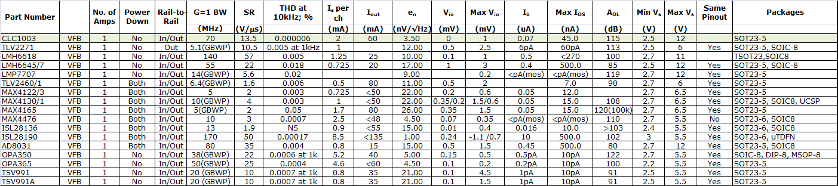
CLC1003 Key Competition

Slide 13

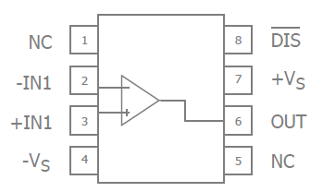
CLC1001 / CLC1002
Ultra Low Noise Amplifiers
Key Features
2-options: Minimum stable gains of 5 or 10
  Minimum Stable Gain of 5 (CLC1002)
    965MHz GBWP
    170V/us slew rate
  Minimum Stable Gain of 10 (CLC1001)
    2.1GHz GBWP
    410V/us slew rate
1mV maximum input offset voltage
0.60nV/√Hz input voltage noise
±130mA output current
Industry Standard SOT23-6 and SOIC-8 pinouts
Applications
Industrial, Instrumentation
  Sensors
  Photo Diode Amplifier
  Diagnostic Systems
  Pre Amps
  Differential Receivers
  Oil drilling
  Radar
Medical
  Ultrasound channel amplifier
  Portable ultrasound
Why We Will Win
Perfect for sensor applications or as a photo diode amplifier
  0.60nV/√Hz input voltage noise
  High bandwidth at large gains
Industries lowest noise amplifiers!!!
  0.60nV/√Hz input voltage noise
Extended operating temperature range
  -40°C to +125°C

Slide 14
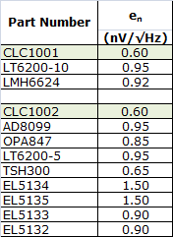
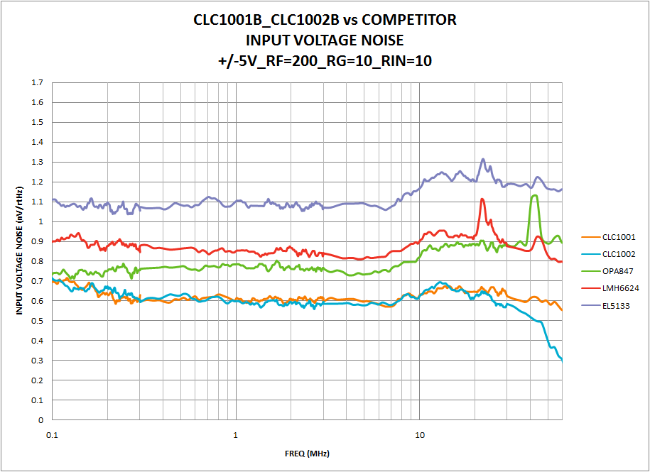
Lowest Noise Amplifiers in the Industry
CLC1001 and CLC1002 offer the industries lowest noise performance
  0.60nV/√Hz input voltage noise
  4.2pA/√Hz input current noise

Slide 15
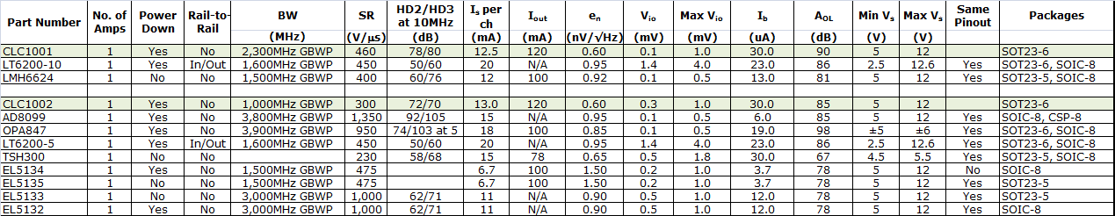
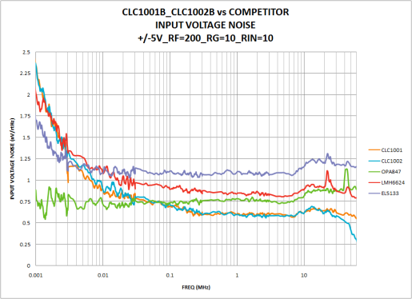
CLC1001 / CLC1002 Key Competition
Industries Lowest Noise High-Performance Amplifiers

Slide 16
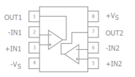
CLC2011
Low Power, Low Cost, Rail-to-Rail I/O Amplifier
Key Features
136μA supply current
4.9MHz bandwidth
Output swings to within 20mV of either rail
Input voltage range exceeds the rail by >250mV
5.3V/μs slew rate
21nV/√Hz input voltage noise
16mA output current
Fully specified at 2.7V and 5V supplies
CLC2011: Pb-free SOIC-8, MSOP-8
Industry Standard pinouts
Applications
Portable/battery-powered applications
PCMCIA, USB
Mobile communications, cell phones, pagers
ADC buffer
Active filters
Portable test instruments
Notebooks and PDA’s
Signal conditioning
Medical Equipment
Portable medical instrumentation
Why We Will Win
More bandwidth than competition at same price point
Great for single supply applications
  Rail-to-Rail input and output
Wide operating temperature range
  -40°C to +85°C

Slide 17
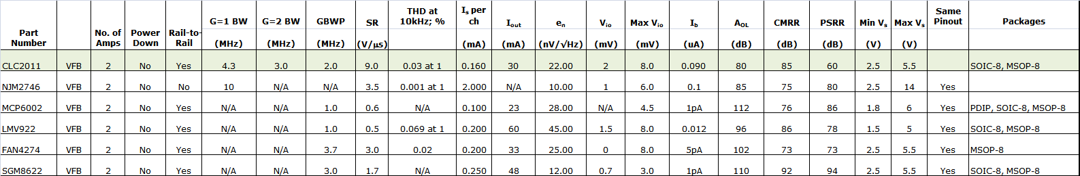
CLC2011 Key Competition

Slide 18
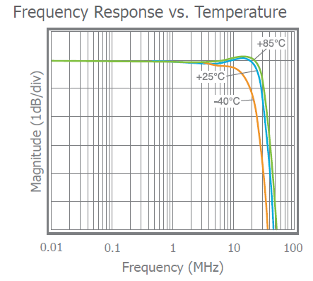
CLC2008
Dual, 0.5mA, +2.7V & +5V, 75MHz Rail-to-Rail Output Amp
Key Features
505μA supply current
75MHz bandwidth
Input voltage range with 5V supply: -0.3V to 3.8V
Output voltage range with 5V supply: 0.07V to 4.86V
50V/μs slew rate
12nV/√Hz input voltage noise
15mA output current
Fully specified at 2.7V and 5V supplies
CLC2010: Pb-free SOIC-8 (MSOP-8 is possible future package)
Industry Standard pinout Typical Performance
Applications
Portable/battery-powered applications
Mobile communications, cell phones, pagers
ADC buffer
Active filters
Portable test instruments
Signal conditioning
Medical Equipment
Portable medical instrumentation
Why We Will Win
More bandwidth than competition at same price point
Lower supply current than competing 50MHz to 75MHz amplifiers
Great for single supply applications
  Rail-to-Rail output
Wide operating temperature range
  -40°C to +85°C

Slide 19
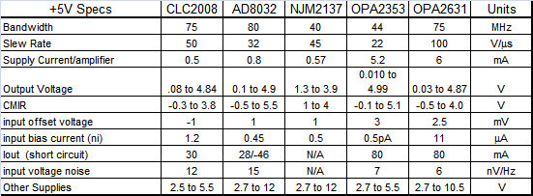
CLC2008 Key Competition

Slide 20

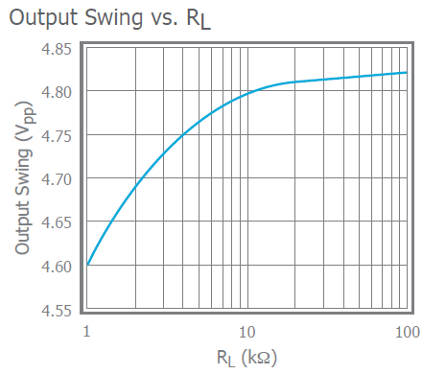
CLC1009, CLC1019, CLC2009
Singles and Dual, 0.2mA, +2.7V & +5V, 35MHz RRO Amp
Key Features
208μA supply current
Power down to 35µA (CLC1019)
35MHz bandwidth
Input voltage range with 5V supply: -0.3V to 3.8V
Output voltage range with 5V supply: 0.08V to 4.88V
27V/μs slew rate
21nV/√Hz input voltage noise
13mA output current
Fully specified at 2.7V and 5V supplies
CLC1009: Pb-free SOT23-5, SOIC-8
CLC1019: Pb-free SOT23-6, SOIC-8
CLC2009: Pb-free SOIC-8 (MSOP-8 is possible future package)
Industry Standard pinouts Typical Performance
Applications
Portable/battery-powered applications
PCMCIA, USB
Mobile communications, cell phones, pagers
ADC buffer
Active filters
Portable test instruments
Signal conditioning
Medical Equipment
Portable medical instrumentation
Why We Will Win
More bandwidth than competition at same price point
Lower supply current than competing 15MHz to 35MHz amplifiers
Great for single supply applications
  Rail-to-Rail input and output
Wide operating temperature range
  -40°C to +85°C

Slide 21
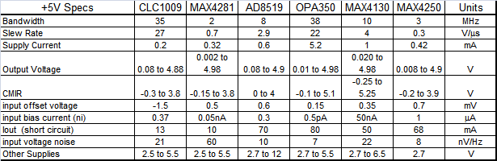
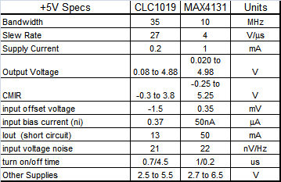
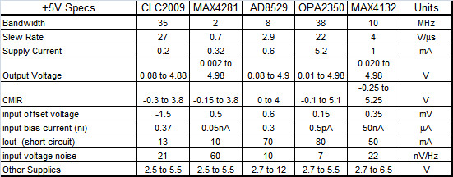
CLCx009 Key Competition

Slide 22
CLC1010, CLC2010
Single and Dual, 70µA, +2.7V & +5V, 7.3MHz RRO Amp
Key Features
70μA supply current
7.3MHz bandwidth
Input voltage range with 5V supply: -0.3V to 3.8V
Output voltage range with 5V supply: 0.04V to 4.96V
9V/μs slew rate
29nV/√Hz input voltage noise
4mA output current
Fully specified at 2.7V and 5V supplies
CLC1010: Pb-free SOT23-5, SOIC-8
CLC2010: Pb-free SOIC-8 (MSOP-8 is possible future package)
Industry Standard pinouts Typical Performance
Applications
Portable/battery-powered applications
PCMCIA, USB
Mobile communications, cell phones, pagers
ADC buffer
Active filters
Portable test instruments
Signal conditioning
Medical Equipment
Portable medical instrumentation
Why We Will Win
More bandwidth than competition at same price point
Lower supply current than competing 1MHz to 10MHz amplifiers
Great for single supply applications
  Rail-to-Rail input and output
Wide operating temperature range
  -40°C to +85°C

Slide 23
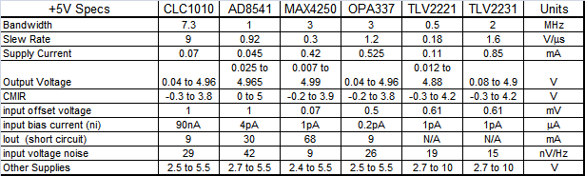
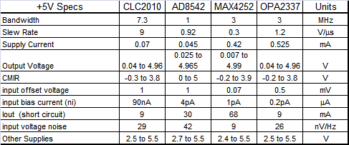
CLCx010 Key Competition

Slide 24
Precession Applications
Oct 23 2012

Slide 25
Existing Precession Applications
Current Shunt
Test equipment
Motor control
Pressure Sensor
Weight Scale Sensor
Flow Meters
Heat flow meter
Heavy industry
Medical
ECG
Pulse Oximeter
Magnetic flow meter
Inverter

Slide 26
Different requirement for high side current sensing
Low Vcomm, high precision, low temperature drift, low noise, low speed current sensing
Batter test equipment
Charging control
Low Vcomm, high precision, low noise, low temperature drift, high speed current sensing
Low voltage inverter
Low Vcomm, low precision, low noise, high speed current sensing
Low voltage motor control, servo
Integrated switching power ( cycle-by-cycle monitoring)
High Vcomm, low temperature drift, low noise, low speed current sensing
High voltage inverter
Isolated current sensing

Slide 27
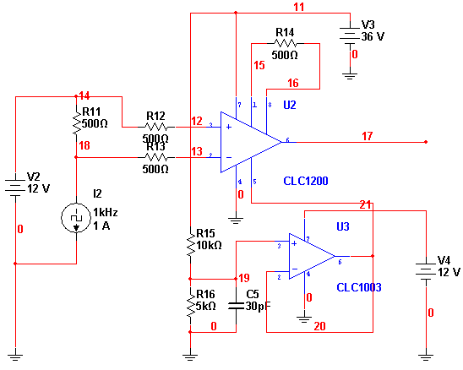
CLC1200 INA Current Sensing

Slide 28
Low Vcomm, high precision, low temperature drift, low noise, current sensing

Slide 29
Advantage
Track common mode voltage change from 3V to 30V( can be extended )
Very low noise
Configurable bandwidth and noise performance
Very low temperature drift
Much higher SNR compare to resistor divider measurement solution.

Slide 30
Variation by different requirement
Lower speed with better DC performance
  Limit the BW and filter more high frequency noise, also lower the integrated noise level
  Higher gain with lower shunt resistor, lower the thermal risk.
Higher speed with better AC performance
  Lower gain to get more bandwidth
  Bigger shunt resistor to get more voltage drop on shunt resistor, allowing lower gain setting.
5V power supply for the amplifier to match 3V/5V ADC with optimized output voltage range
12V power supply for the amplifier to extend common mode voltage to 48V or higher common mode voltage range

Slide 31
Optimize for different performance
Change gain
Change BW limit and phase margin
Change shunt resistor
Change Vcc to extend the input common mode voltage level.

Slide 32
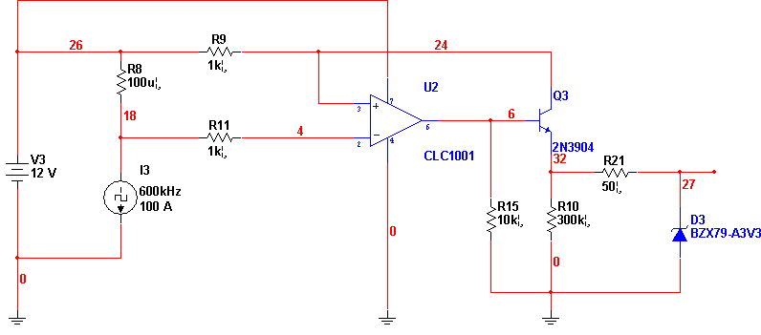
High speed current sensing

Slide 33
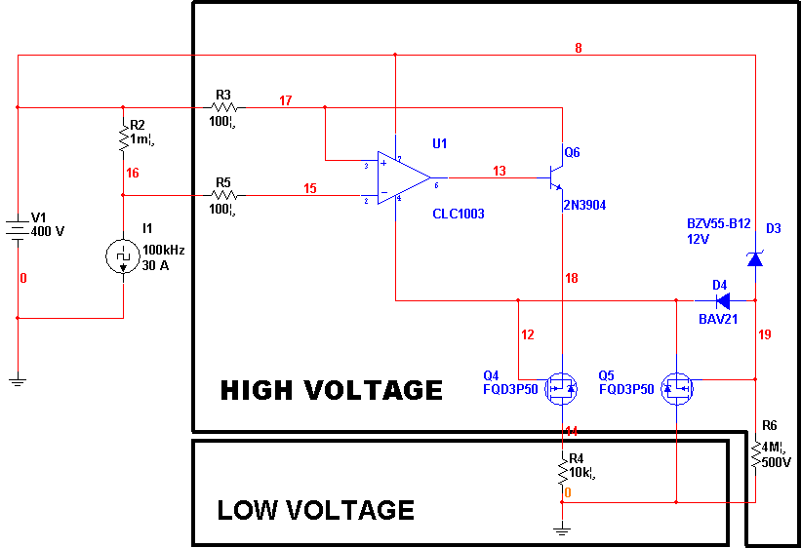
High voltage current sensing

Slide 34
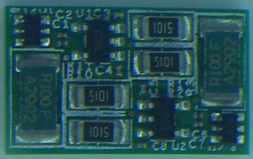
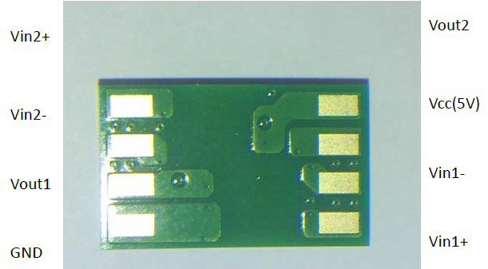
Current sensor module
Small size
Flexible input common mode voltage range adjustment
Flexible sensing range and output voltage range adjustment
Low cost
Shorten design cycle at system level
Customize requirement accepted for module

Slide 35
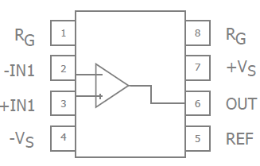
Pressure Sensor
High end – Instrumentation amplifier CLC1200
Low end – Precision amplifiers, CLC1003

Slide 36
Weight Scale Sensor
High end – Instrumentation amplifier CLC1200
Low end – Precision amplifiers, CLC1003

Slide 37

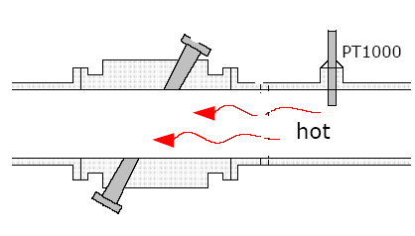

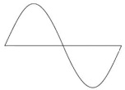

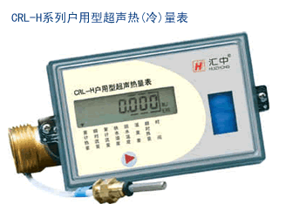
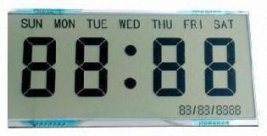
Flow Meters
两相超声波脉冲
MSP430
热表水表行业很认可 TI 430的低功耗
Battery
Timer
超声波换能器
超声波换能器
ADC
3.6V ~4.2V
Li-on battery
直接供电
热敏电阻
超声波换能器
Analog SW
Amp.
TI TSS721(标配)
输入捕获
+定时器，
测量相位差。
M-bus
interface
M-BUS
20mV-50mV
RS-485
微功耗485/MAX
option
I2C
LCD driver

Slide 38
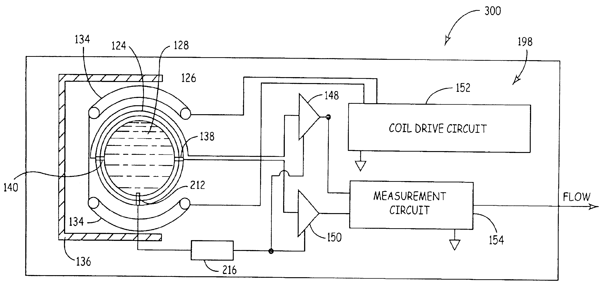
Flow Meters - continue
CLC1200

Slide 39
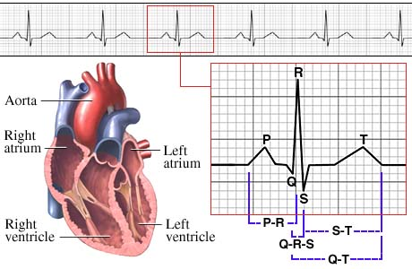
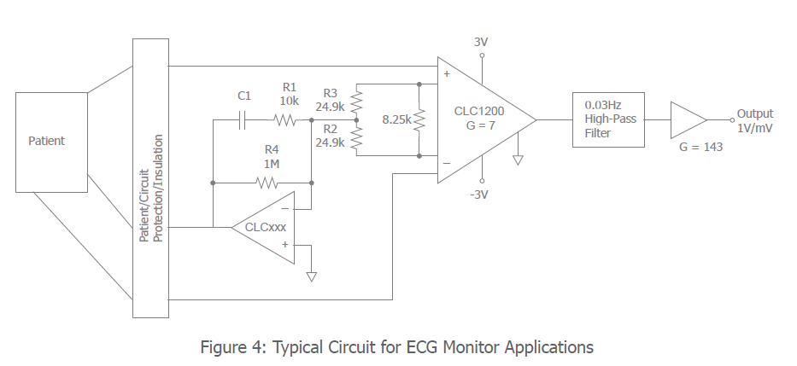
ECG
CLC1200, better frequency response in low gain setting compare to AD620.

Slide 40

Pulse Oximeter
CLC2011
RRIO makes it easy to design
Better linearity than CMOS OPAMP
Low cost
DAC CH1
MCU
LED Driver
RED LED
IR LED
DAC CH2
CADEKA amps
ADC CH1
ADC CH2
Photo coupler
CADEKA amps

Slide 41
Precession relate spec and significance
Oct 24 2012

Slide 42
Input Offset Voltage
Input offset voltage (V_{IO})
  The voltage that must be applied between the inputs of an amplifier to make the output voltage zero.
  VIO is usually attributed to the input diff pair in a VFB amplifier. Bipolar input stages tend to have lower offset voltages than CMOS or JFET input stages.
    Input offset voltage is important whenever DC accuracy is required in a circuit.
  Measured with input centered at mid-supply
Notes:
All op amps require a small voltage between their inverting and non-inverting inputs to balance mismatches due to unavoidable process variations. The required voltage is known as the input offset voltage.

Slide 43
Input Offset Current and Input Bias Current
Input bias current (I_{bn} for VFB and I_{bn}, I_{ni} for CFB)
  The current required at the inputs of an amplifier for proper operation
    CFB amplifiers have different input bias currents for inverting and non-inverting inputs
    CMOS and JFET inputs traditionally offer much lower input current than standard bipolar inputs. However, the FHP3350 with bipolar inputs offers a strikingly low Ib of 0.05uA typical and 0.3uA max.
    Input bias current is important when the source impedance is high, if the op amp has high Ib it will load the source resulting is a lower than expected voltage.
      If an amplifier has high Ib, the source impedance can be lowered by using a buffer stage to drive the op amp.
Input offset current (I_{IO})
  The difference between the two input currents of an amplifier
    Offset current can be nullified by matching the impedance seen at the inputs.
Above are measured with input centered at mid-supply
Notes:
All op amps require a small voltage between their inverting and non-inverting inputs to balance mismatches due to unavoidable process variations. The required voltage is known as the input offset voltage.

Slide 44
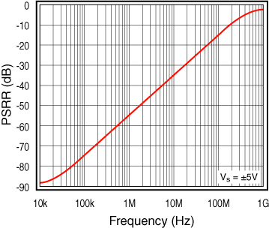
Power Supply Rejection Ratio
PSRR
  A measure of how well an amplifier rejects changes in power supply levels
  The change in input offset voltage per unit change in power supply voltage
  PSRR at low frequencies is dependent on the amplifier, at higher frequencies, it is dependent on power supply decoupling
  The data sheet specs this at DC, the plot pages show PSRR vs Freq.

Slide 45
Open Loop Gain and Supply Current
A_{OL}
  The differential gain if the amplifier without feedback (Open-loop)
    Is measured by the change in input offset voltage with respect to a unit change in the output swing.
      Higher A_{OL} reduces error in closed-loop
      V_{out} = V_{in} * ( G ) For G=10 A_{OL}= 50dB or 316V/V
      1 + G/A_{OL} V_{out} = V_{in} * 9.69 a 3% error due to low A_{OL}
  Referred to as open loop transimpedance gain (Z_{OL}) for a Current Feedback (CFB) amplifier.
    The unit change in error current ( inverting input current ) with respect to a unit change in the output swing.
I_{S}
  Current drawn by amplifier at no load

Slide 46
Input Resistance and Capacitance
R_{IN}
  Input resistance is the resistance between the inputs with either input grounded
C_{IN}
  Input capacitance is measured between the inputs with either input grounded
R_{OUT}
  Small signal impedance between the output terminal and ground.
    Output impedance is a design issue when using a RRO amp to drive heavy loads. If the load is mainly resistive, the output impedance will limit how close to the rails the output can go. If the load is capacitive, the extra phase shift will erode phase margin.

Slide 47
Common Mode Input Range
CMIR
  The common-mode input signal range for which an amplifier remains linear
    Exceeding the CMIR of an amplifier could cause the signal to clip, go to the rail, or even cause the amplifier to oscillate
  Rail-to-rail input (RRI) amps use complementary N- and P-type devices in the differential inputs. When the common-mode input voltage nears the rail, at least one of the differential inputs is still active, and the CMIR includes both rails
    Lower and lower V_{s} make CMIR an increasing concern
    RRI amps are required when driving a single supply ADC or as a high-side current sensing circuit

Slide 48
CMIR and the Inverting Amplifier
By definition, V_{inv} will track V_{non-inv}
  Which in most inverting applications is GND or tied to some voltage to adjust the common-mode
Running inverting is like directly driving the output stage
R_{f}
R_{g}
R_{O}
CLCxxxx
V_{inv}
V_{non-inv}

Slide 49
CMIR and the Inverting Amplifier
For split supply applications,
  V can exceed the amplifier’s CMIR
Example
  Amplifier CMIR at ±5V is -5 to 4V
  If V = 4.5V_{pp}, V_{inv} still = 0V
    In this condition, it is important to watch the amplifier’s output swing limit.
R_{f}
R_{g}
5V
V
R_{O}
FHPxxxx
V_{inv}
-5V
V_{non-inv}

Slide 50
Headroom and Rail-to-Rail
What is Rail-to-Rail
  Rail-to-rail implies that the common mode input range or output range of an amplifier will extend to (or very close to) the supply rails.
  For rail to rail inputs it is possible to design the amplifier to include or exceed the supplies
    Necessary for high side current sense applications or signals that include ground

Slide 51
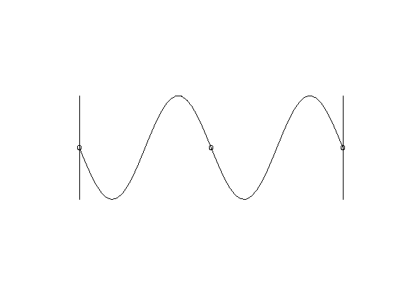
Headroom and Rail-to-Rail
Why is Rail-to-Rail Performance Important?
  Dynamic Range
  Power Consumption
    Power Dissipation = Supply Current x Supply Voltage
Vs = ±15V
+15V
Headroom requirement from positive rail
Vs = ±5V
+5V
Vs = +2.7V
+2.7V
GND
Headroom requirement from negative rail
-5V
-15V

Slide 52
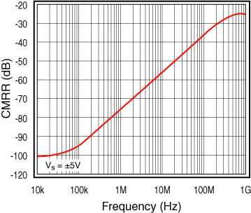
Common Mode Rejection Ratio
CMRR
  A measure of how well a differential amplifier rejects signals common to both inputs
    From a DC standpoint, this translates to the change in input offset voltage per unit change in input common mode voltage.
    The data sheet specs this at DC, the plot pages show CMRR vs Freq.

Slide 53
Output Voltage Swing
V_{O}
  The maximum output signal that can be obtained without wave form clipping.
    Specified for a given Load Resistance
      Attempting to exceed Vo, results in recovery issues from causing the output stage to become very Non-Linear or Saturated.

Slide 54
Output and Output Short Circuit Current
I_{OUT}
  Current driving capability of the amplifier, determines minimal load driving capability
I_{SC}
  The maximum continuous output current available from the amplifier with the output shorted to ground.

Slide 55
Lookout for Data Sheet “Marketing”
Most manufacturers specify output current with the output centered between the supplies.
  This is the least strenuous condition.
  This must be taken into consideration when running from single supply and operating DC-coupled.

Slide 56

Thanks you all!!
Any Question?
大盛唐电子集团有限公司
www.szdst.com.cn

